Slide 1
The world’s most loved product management software

Slide 2
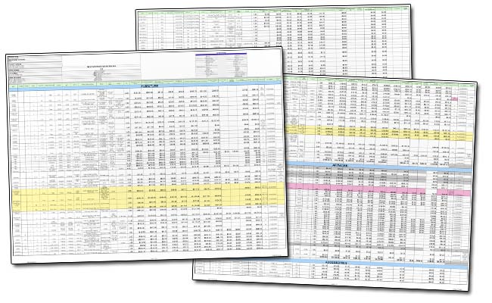
Let’s talk about the one thing getting in the way of your greatest product possible.

Slide 3
SPREADSHEETS.
Complicated
Siloed
Uninspiring
Impossible to visualize
Bloated
Feature-driven
Uncoordinated
Opaque
Not shareable

Slide 4
Spreadsheets are where ideas go to die.
IDEA!
“That’s brilliant! Let’s put it in the spreadsheet/send me an email.”
[QUICKLY LOST/FORGOTTEN]
[two months later…]
“Who came up with this nonsense? Why’s this here?”

Slide 5
Spreadsheets are black holes
where ideas enter and rarely re-emerge.
DEVS don’t look at them.
They end up working on poorly cobbled specs and a lot of guesswork.
SALES doesn’t care enough to look at them.
They promise leads and customers features that don’t exist (and never will.)
SUPPORT has just kind of given up.
They have lots of ideas from their daily interactions with customers, but they have no way of drumming up support or consensus around them.
Surprise! No one’s happy.

Slide 6
I’ve never seen this before.
What’s the point of this?
And it makes product planning unpleasant and sometimes scary.
Killing great ideas before they can ever grow into something
Making your customers skeptical of your promises
Creating planning and production delays at work
Making it hard for you to make confident product decisions
Rolling out features whose value your team can’t communicate to customers
Causing your teammates to feel unheard
Who signed off on this?
This feels like a waste of time

Slide 7
So let’s start over.

Slide 8
Remember your product vision, goals and KPIs?
I.
Write them down and share them with the whole team.
(Yes, even sales.)

Slide 9
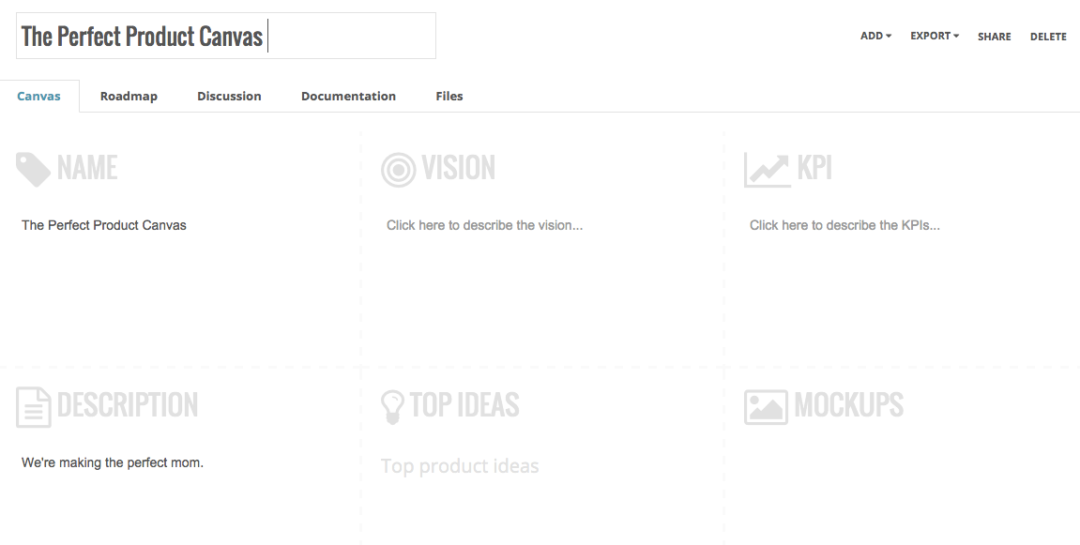
Your Product Canvas

Slide 10
Now everyone knows what we’re here to do. It’s there in writing.

Slide 11
All your feature requests and ideas backlog?
II.
Draw up broad themes for your product and assign ideas to them.
(Next you’ll put the themes into: Current, Short-Term and Future.)

Slide 12
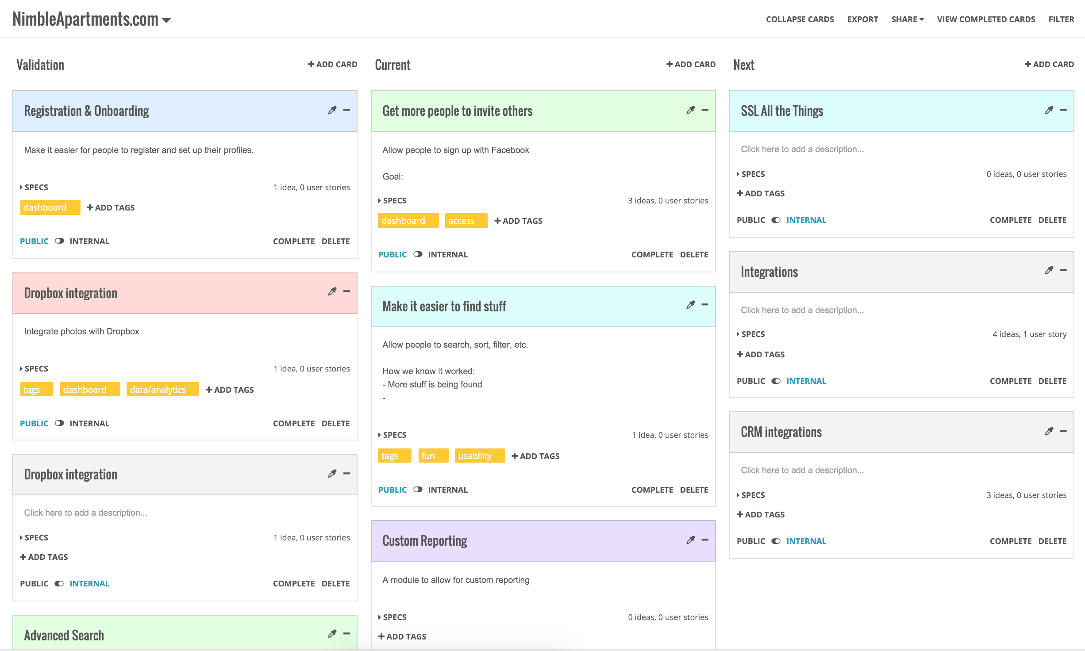
Your Roadmap

Slide 13
Now everyone knows what our priorities are as a business, today, tomorrow and down the line.

Slide 14
What about all those new ideas?
III.
Keep capturing them from your team and customers.
(Your team will be able to vote internally. So will your customers.)

Slide 15
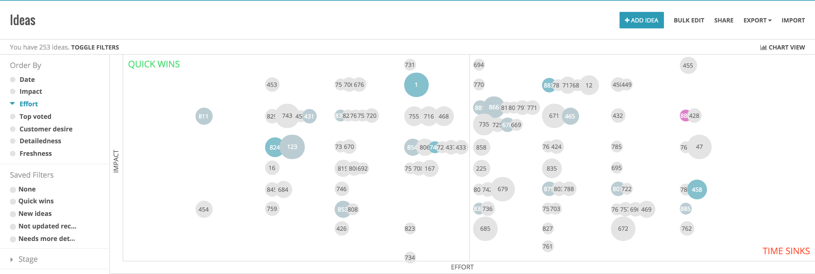
Your ideas backlog

Slide 16
Now everyone’s getting involved because they can see decisions as they’re being made. Plus they can influence the product’s future.

Slide 17
And sending specs over to devs?
IV.
Send them what they’ve always wanted: clear requirements, use cases, business context and purpose
(Hey, they’re part of the team too.)

Slide 18
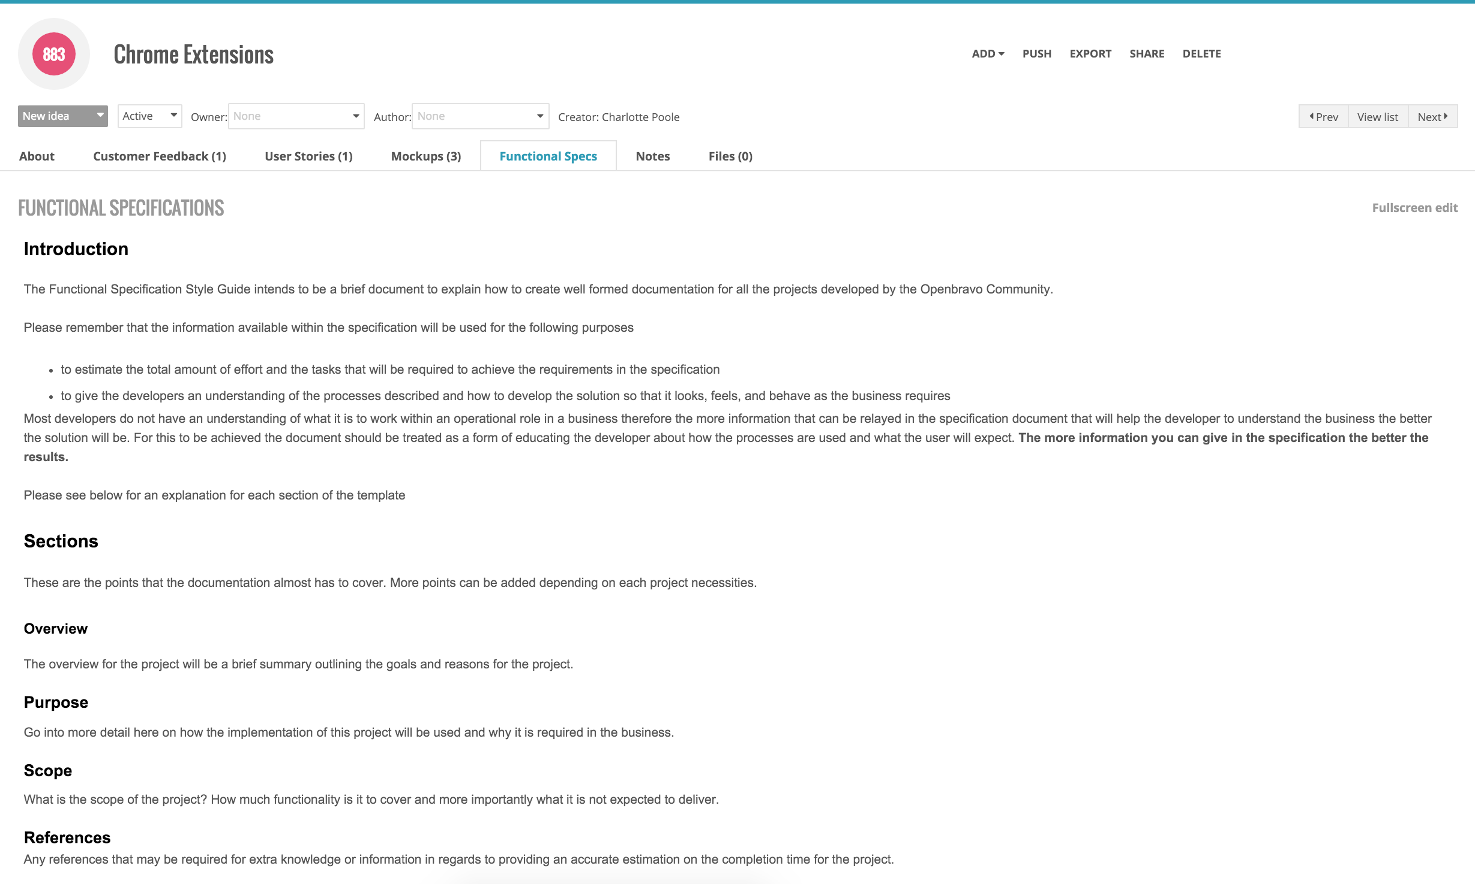
Your spec template

Slide 19
Now you don’t have to deal with expensive delays, backups and production stage debates. The feature is a go.

Slide 20
Everyone pitches in ideas
Plan around themes, not features
Change priorities flexibly
Hold votes and discussions
gives you a better way to manage your product.

Slide 21
Ready for a closer look at
?

Slide 22
Run a lean product ship that can withstand sudden changes and setbacks.
Toggle between Current, Near-Term, Future
Change your plans fast with merge and drag-and-drop options
Link to ideas backlog
Share with customers (embed, print & publish)

Slide 23
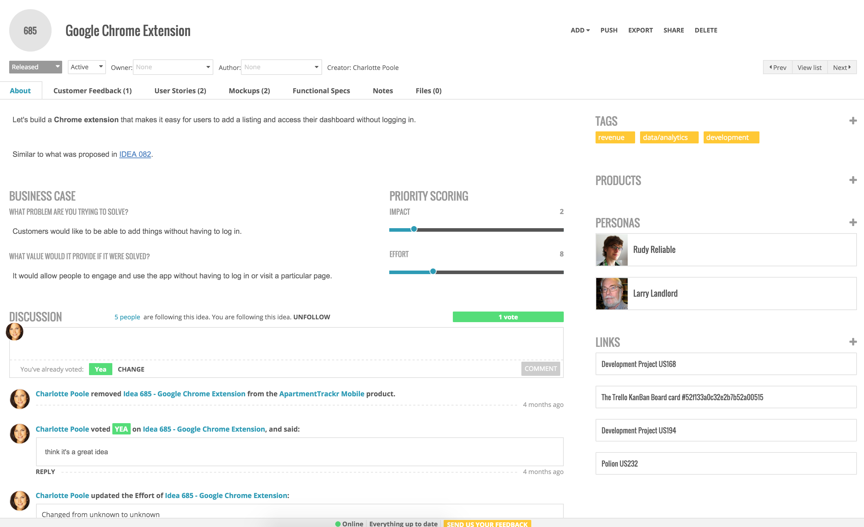
Quickly organize every idea from your teams and customers.
Capture ideas and requests internally from anywhere: email, Chrome extension or online form
Create new idea from customer feedback
Quickly understand priority based on Effort vs. Impact graph, team voting and customer desire.

Slide 24
Get everyone involved in the product’s future.
Push ideas with lots of supporting customer feedback to the top
Allow team members to make the case and collect support for their ideas
Stir a healthy debate around the company with discussions and voting

Slide 25
Build perfectly clear specs and workflows for the devs.
Specs are simple (one page), clear, and all in one place
Flesh out specs & designs in ProdPad
Use the wizard to ensure specs are clear, complete and approved
Push finished specs to JIRA, Rally, Trello and more
Let the dev team see what’s coming down the pipeline and give them context so they know the purpose behind what they’re building.

Slide 26
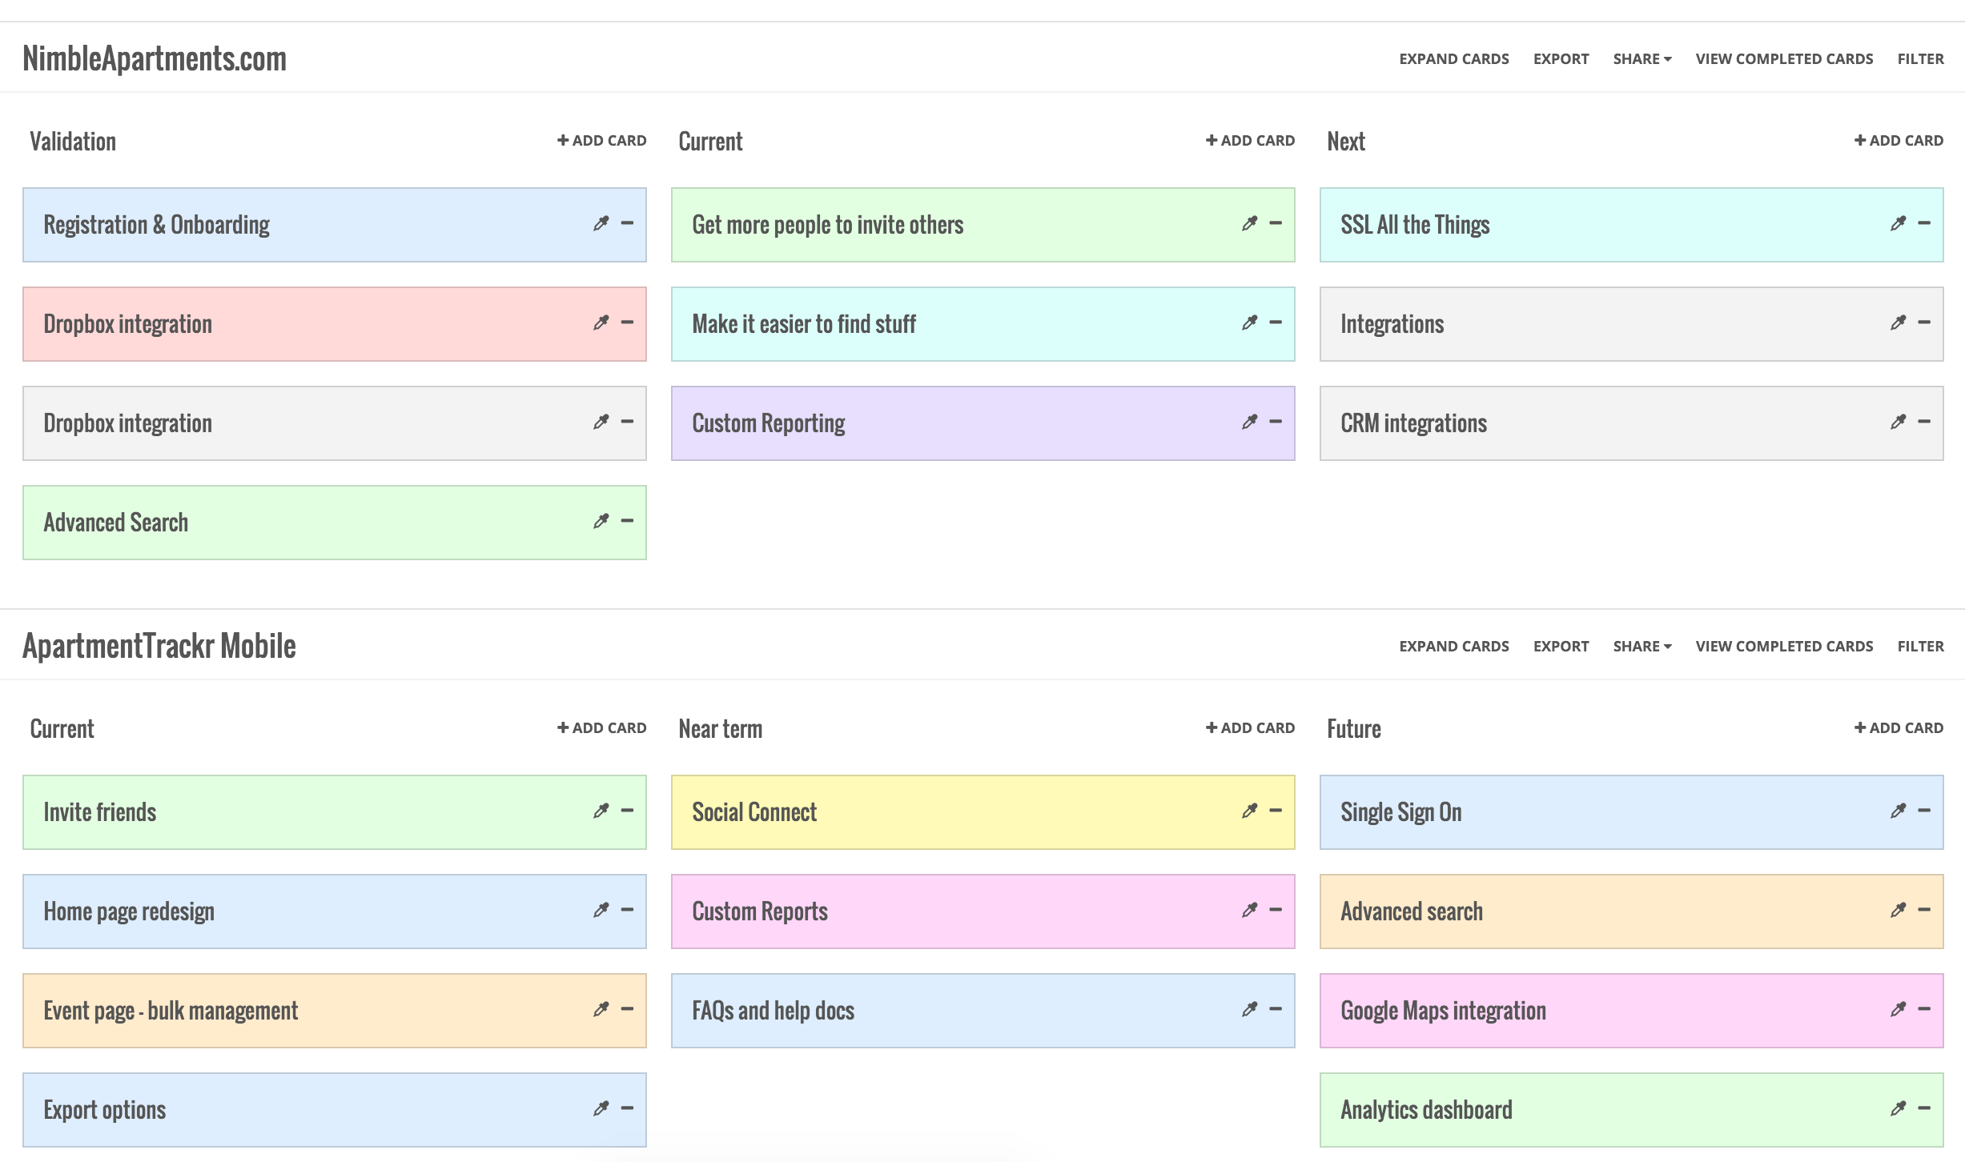
Multiply across your entire product portfolio.
Big business and enterprise companies can stay just as organized
Manage multiple products (unlimited!)
Include product vision, KPIs, user personas, and product strategy - so everyone has the same context
High-level view of ‘portfolio’ roadmap for VPs and CxOs

Slide 27
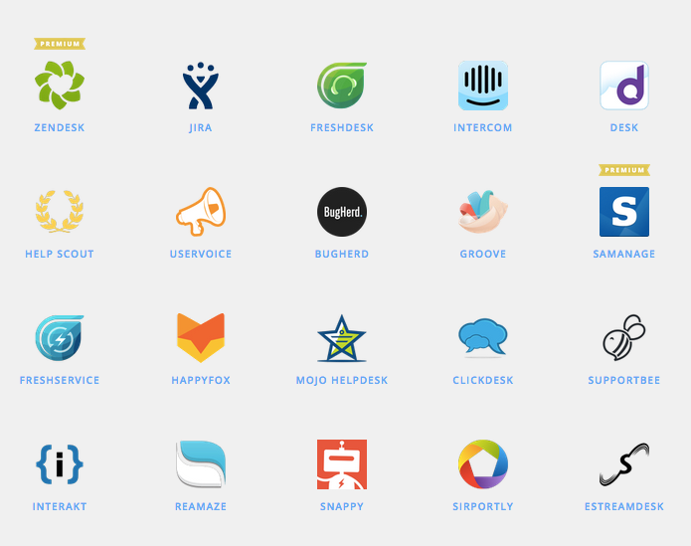
Integrates with the tools you already use (via Zapier)

Slide 28
brings together your
people
products ideas
(And it changes the way your business runs right under your nose.)

Slide 29
That’s why
is at the
of the world’s most-loved products.

Slide 30
QUESTIONS?

